Slide 1
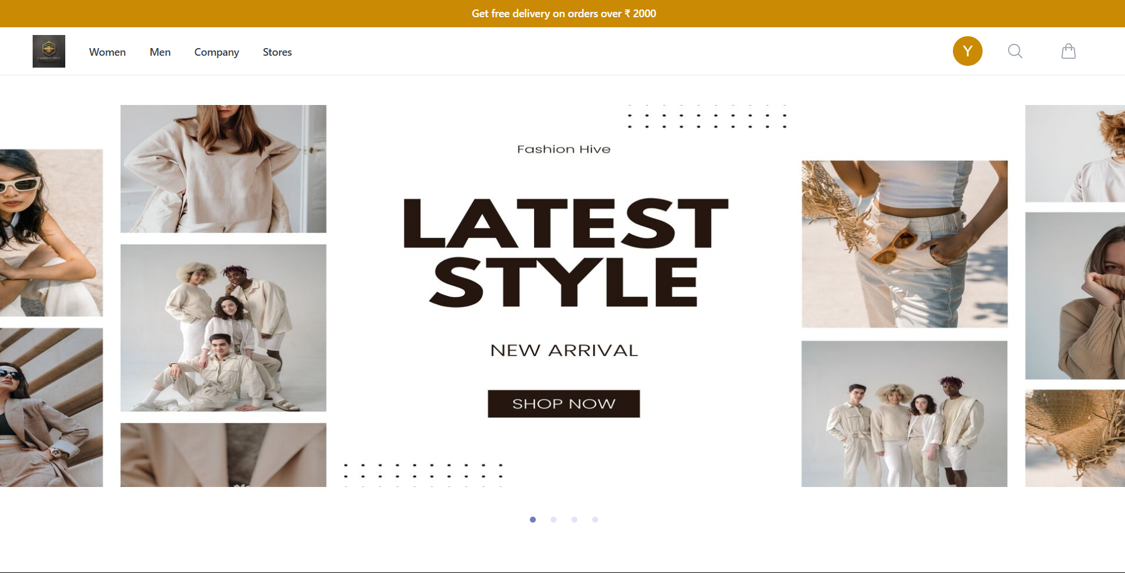
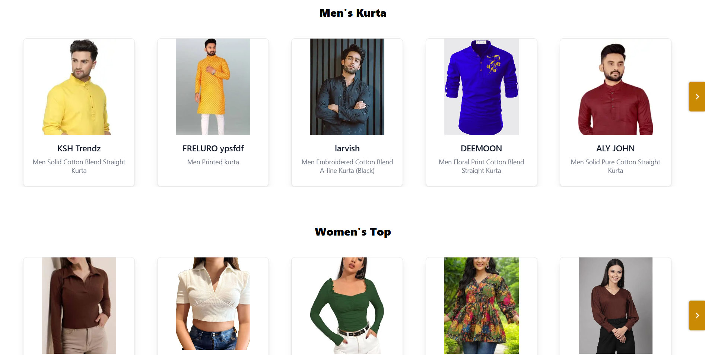
Fashion Hive: Full-Stack E-Commerce Platform
This presentation introduces Fashion Hive, a full-stack website designed for buying and selling fashion and accessories. The platform offers a seamless shopping experience with well-organized categories for Men and Women, each subdivided into Clothing and Accessories. Multiple subcategories enhance navigation and product discovery, ensuring users can easily find stylish and trendy items tailored to their preferences.

Slide 2
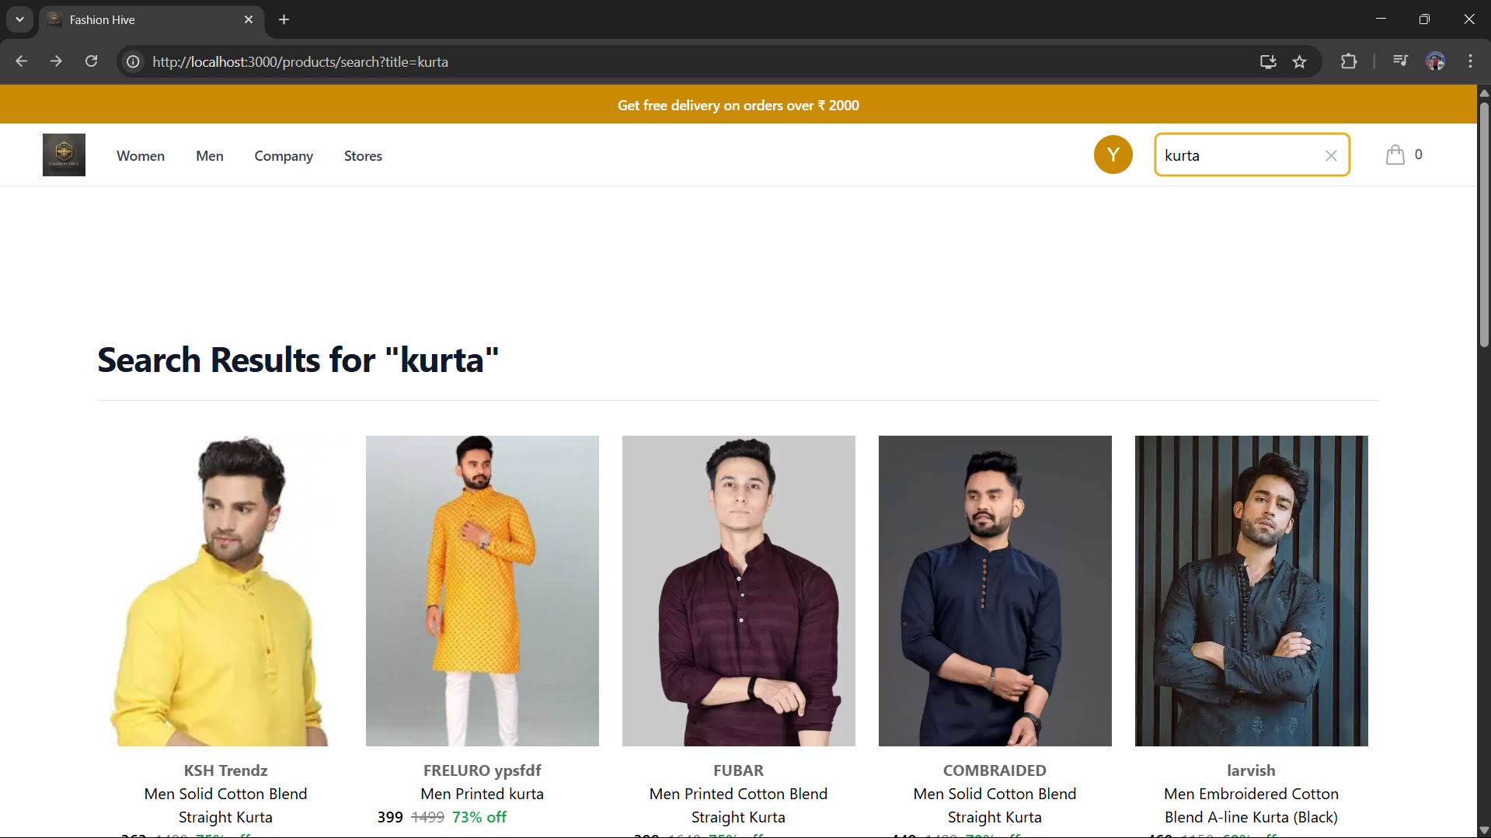

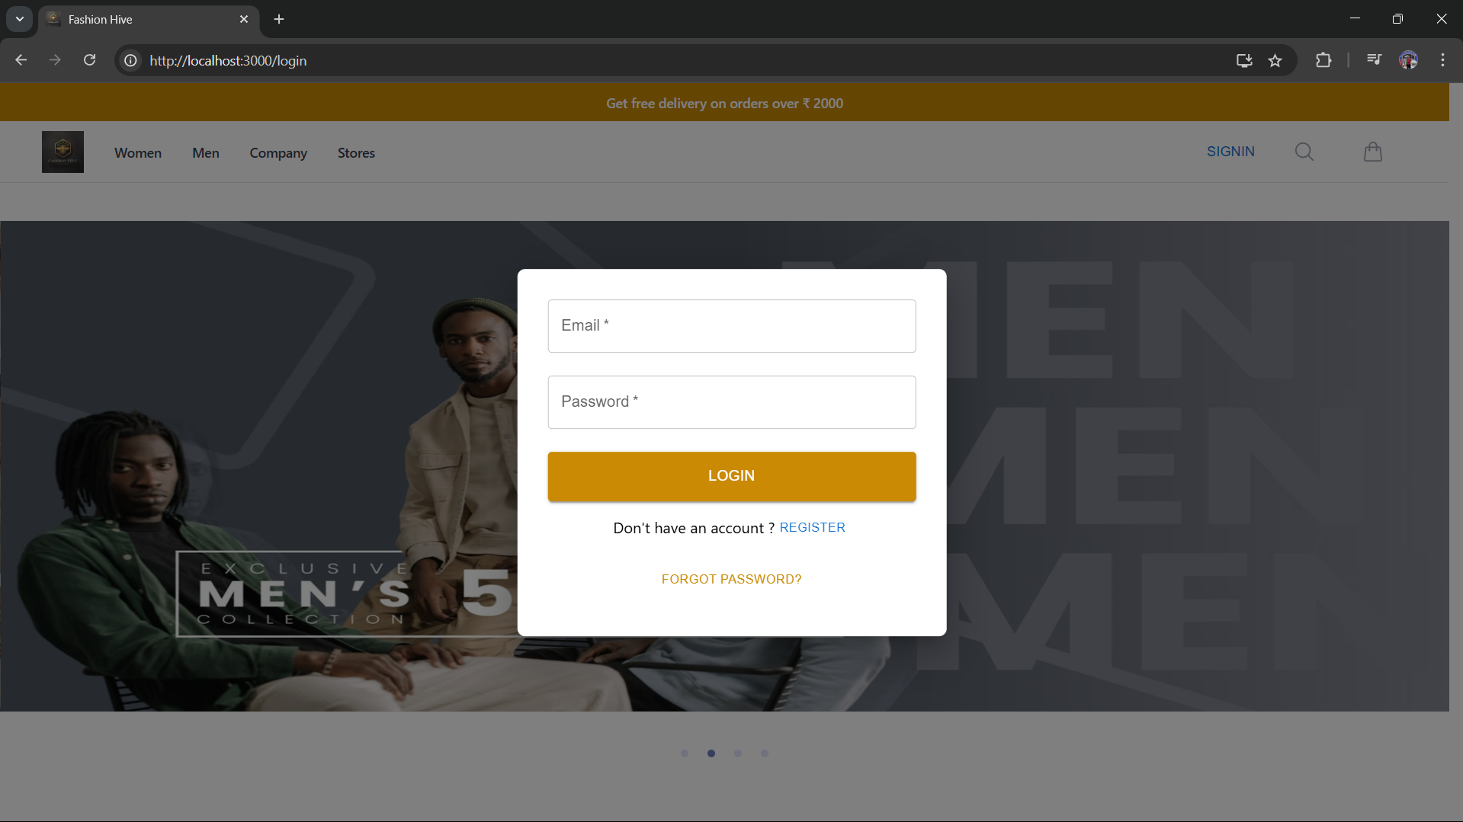


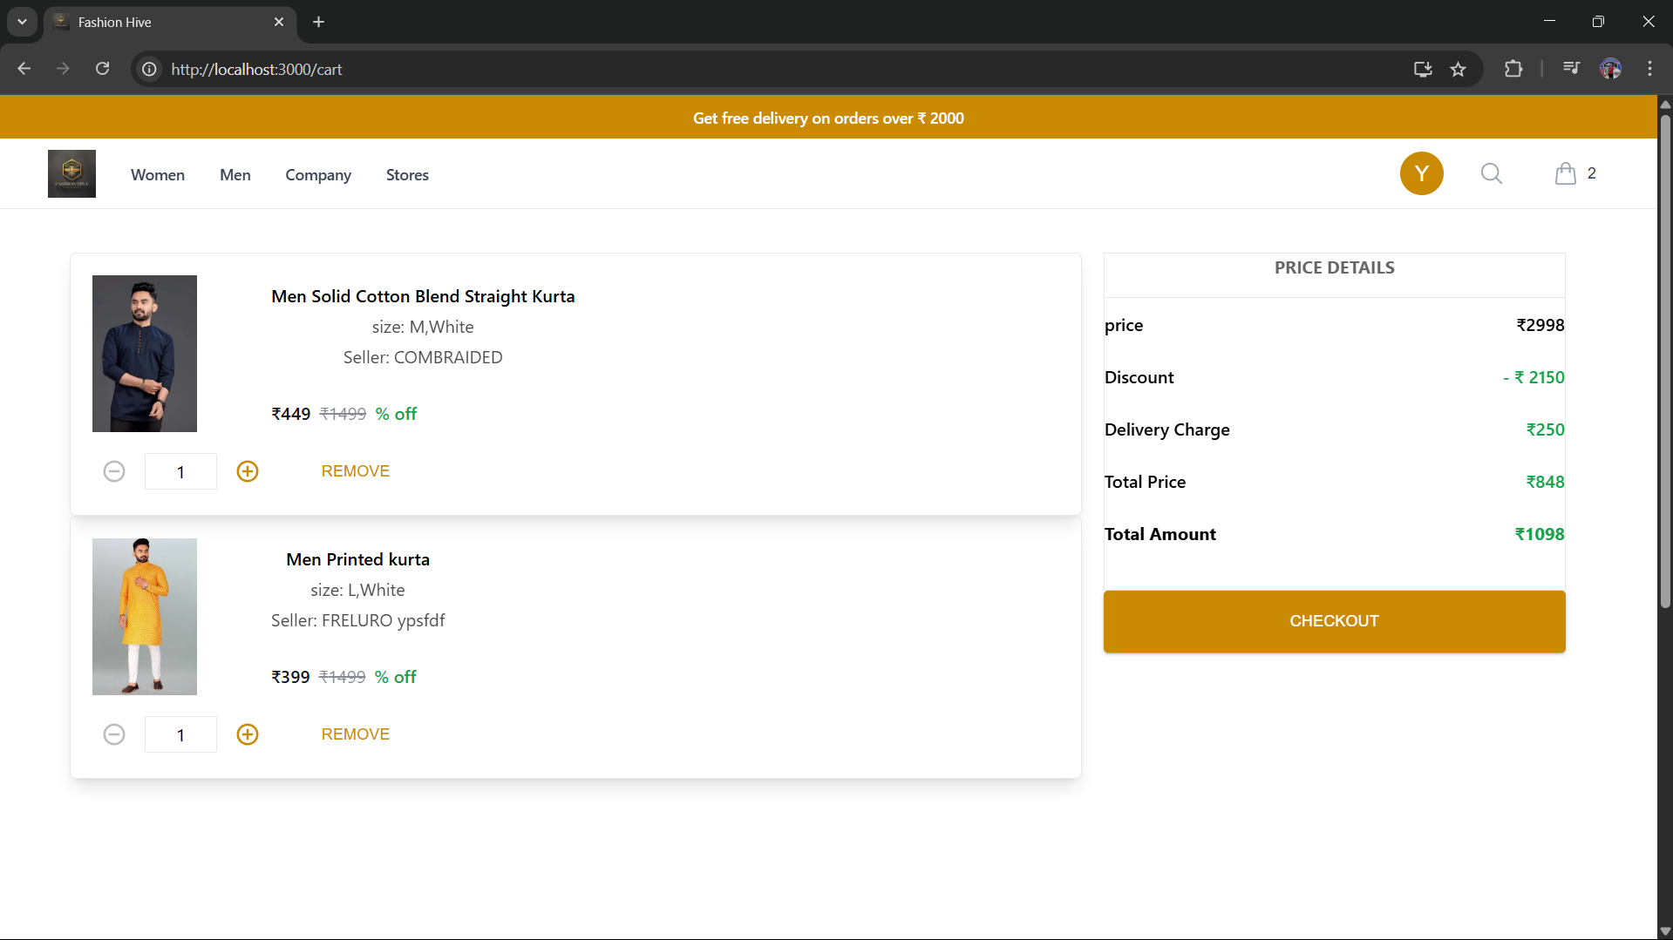
User Experience Workflow
Browsing & Searching
Users can explore products without logging in, using search, filters, and sorting to find desired items.
Login/Register
To place orders, users must create an account or log in, ensuring secure transactions and personalized service.
Adding to Cart
Selected products can be added to the cart for review before purchase.

Slide 3
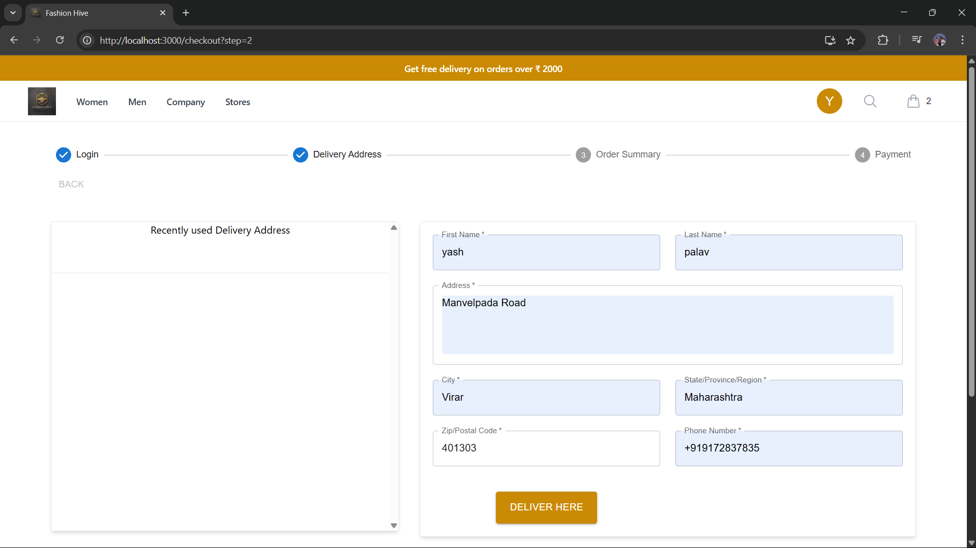
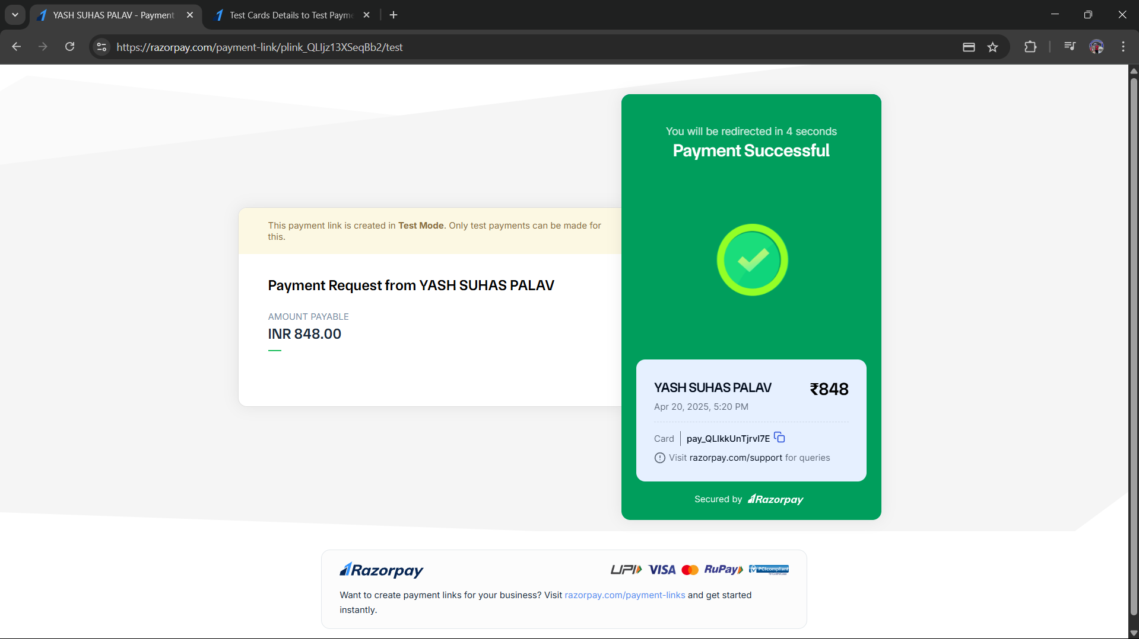
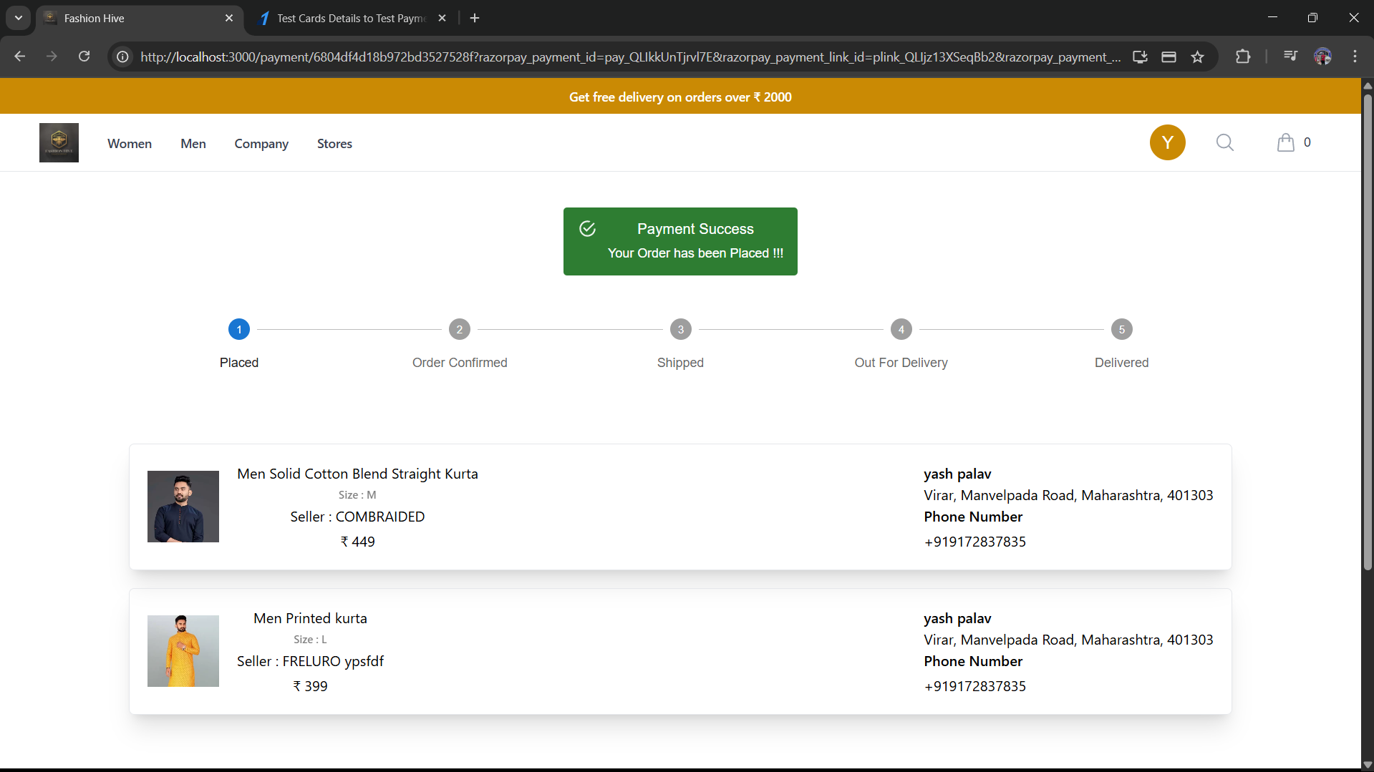

Order Placement Process
Delivery Address
Users provide delivery details to ensure accurate shipment.
Payment
Multiple payment methods are supported for convenience and security.
Order Confirmation
Successful payment redirects users to an order summary and status tracking.

Slide 4
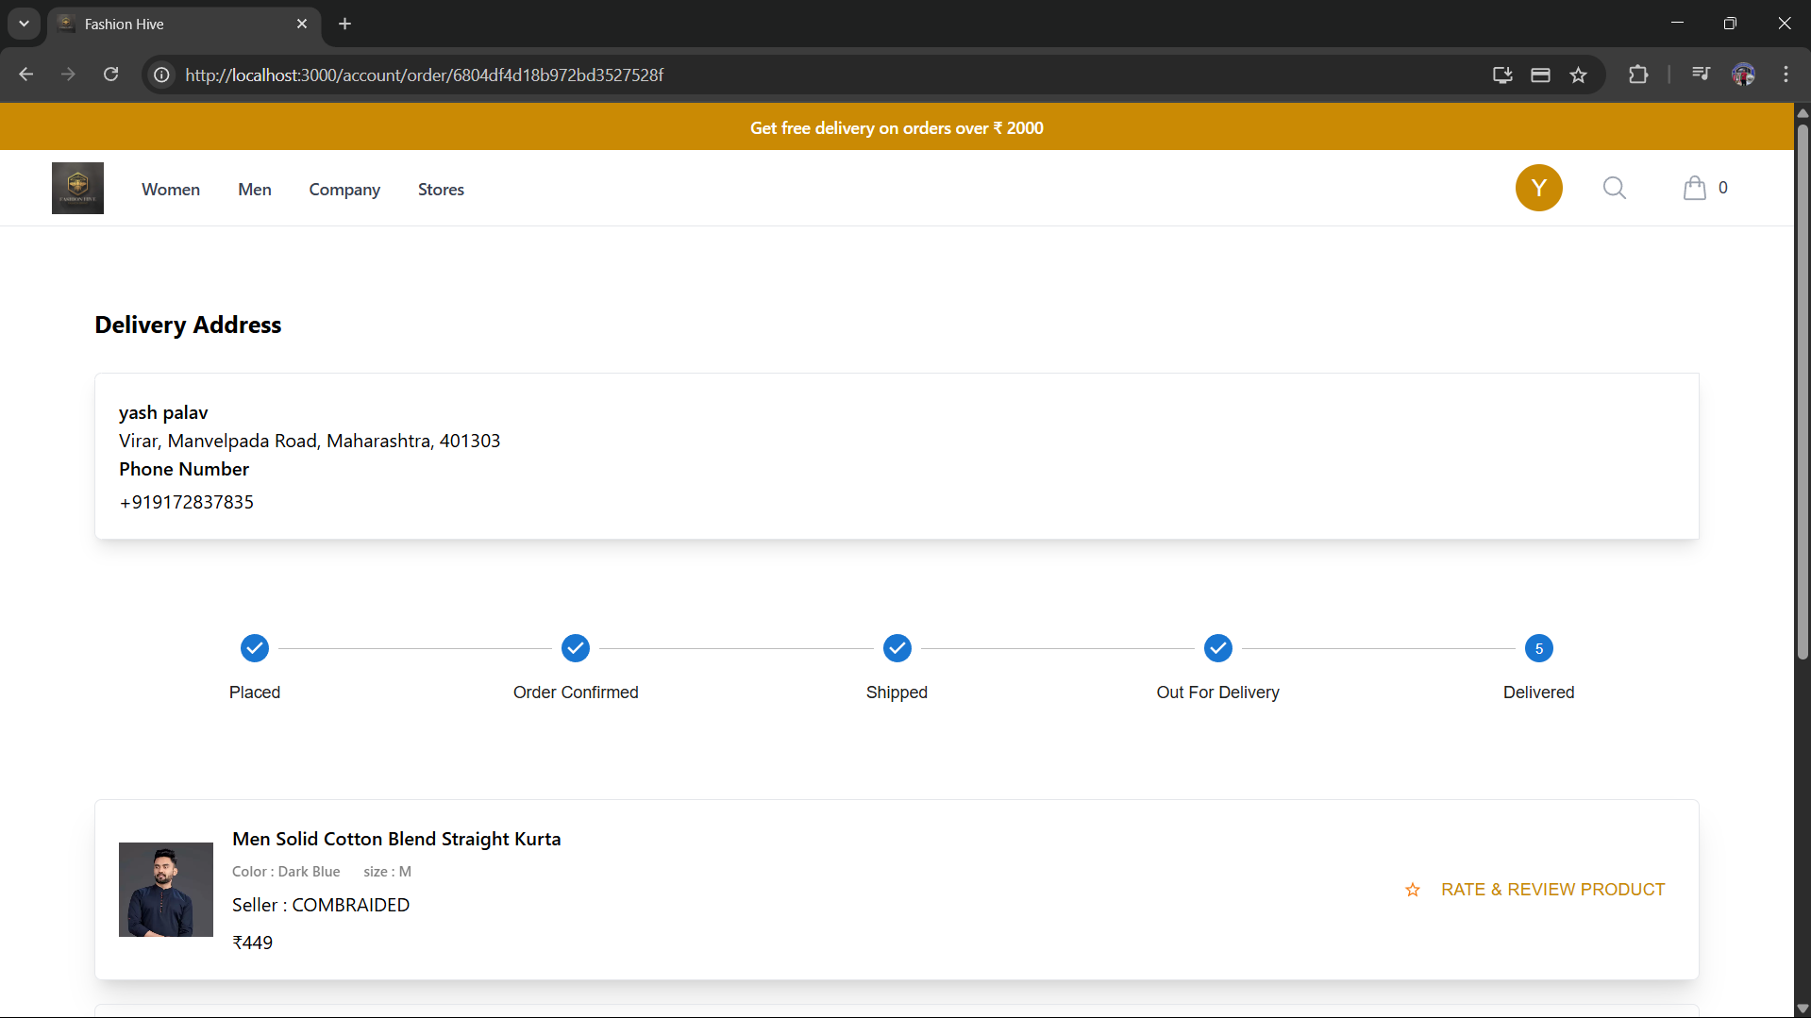
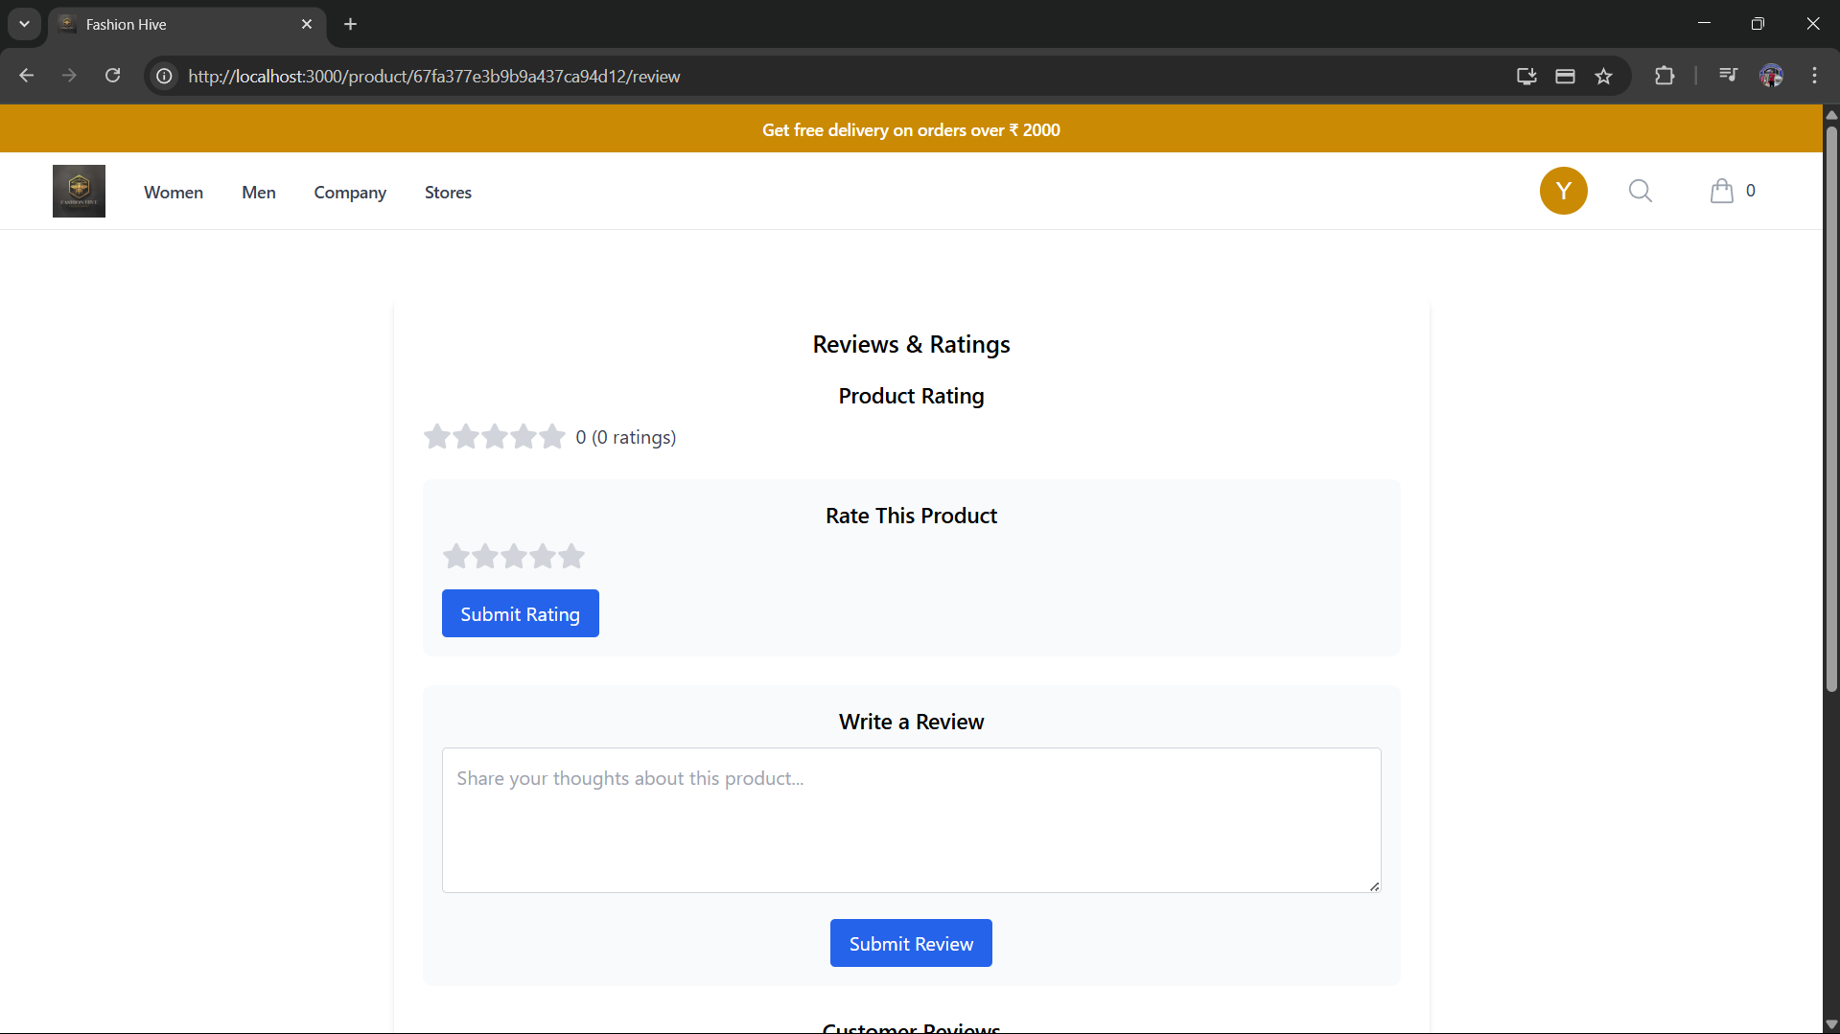
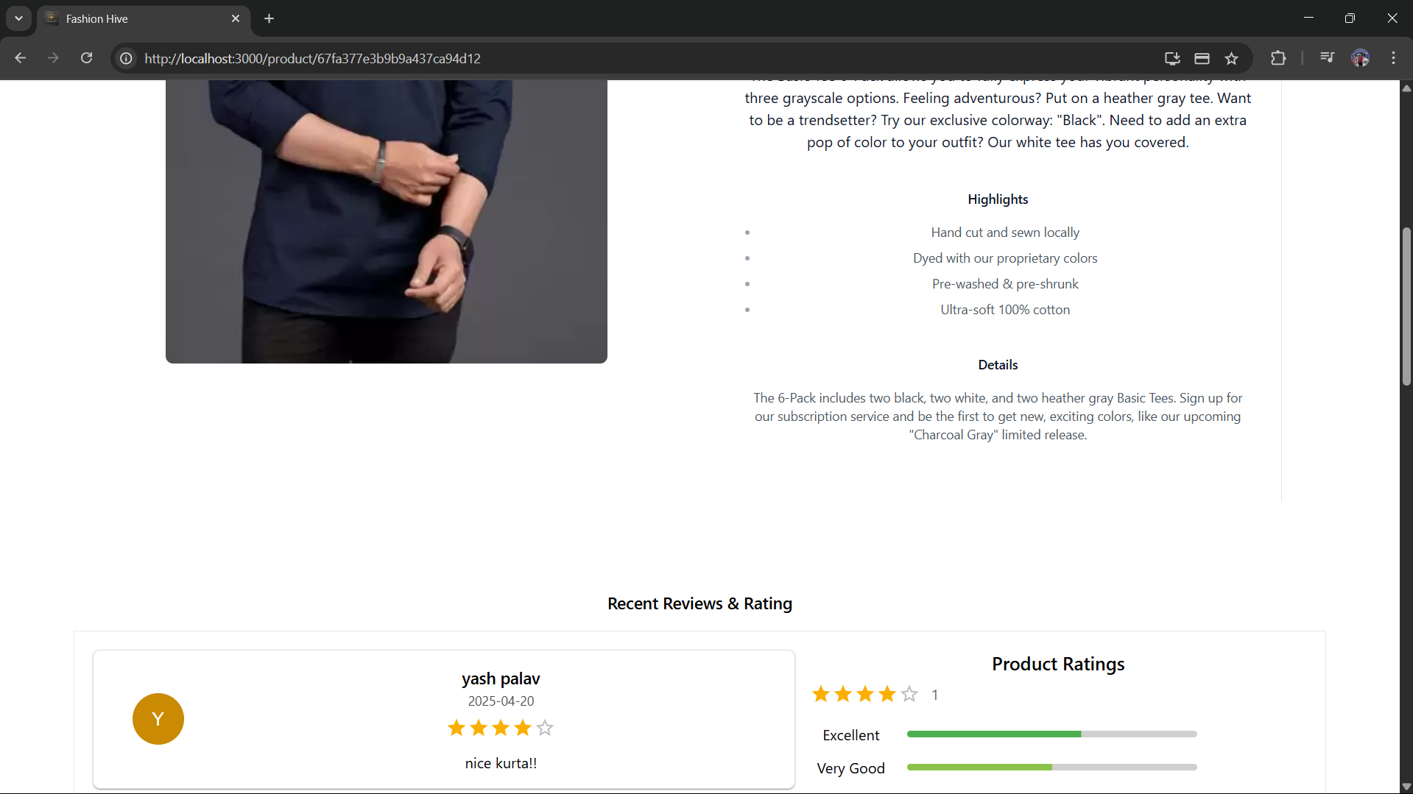
Post-Order Features
Order Tracking
Product Ratings
Users can monitor their order status from processing to delivery.
After delivery, users can rate products to share their experience.
Reviews
Customers can write detailed reviews visible on product pages.

Slide 5
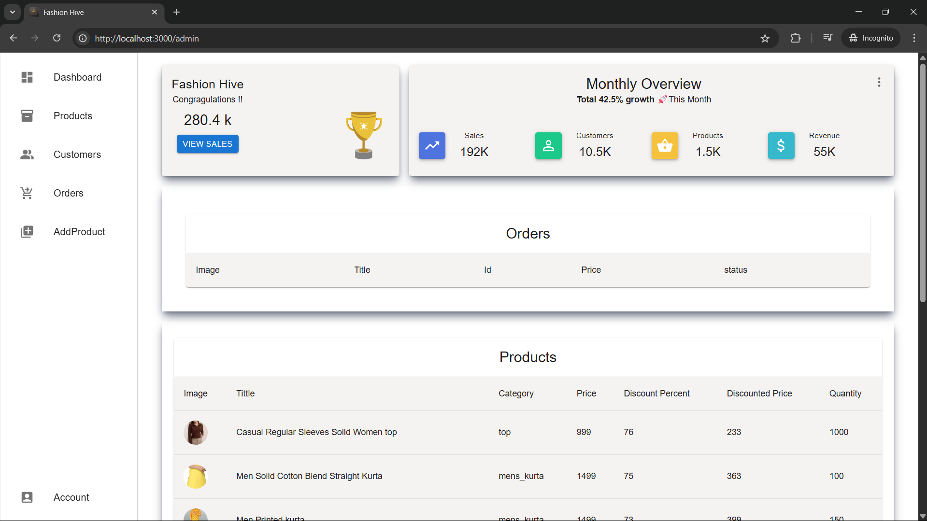
Admin Panel Overview
Admin functionality dashboard
Admin can have access to the dashboard where he can control
Everything in website. The dashboard include all the information about
the Products ,orders ,sales ,users.

Slide 6
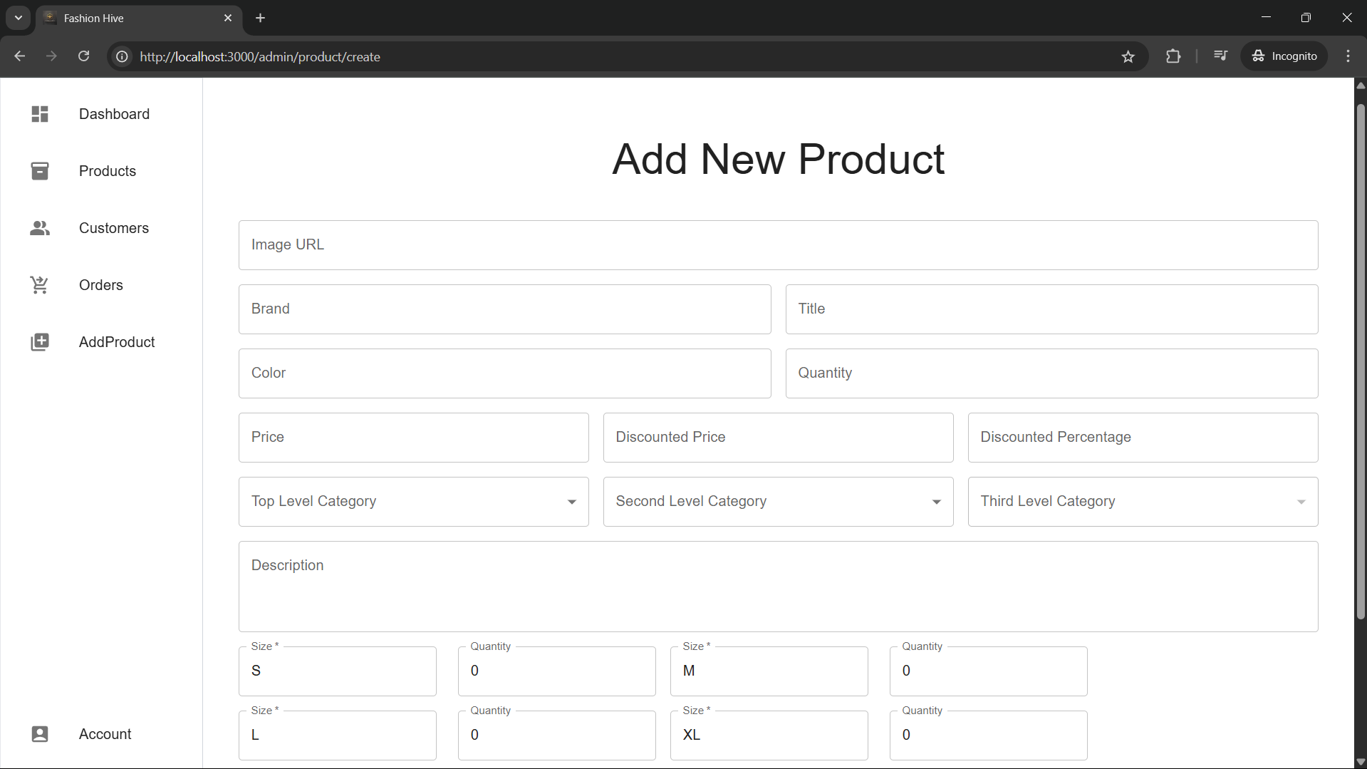
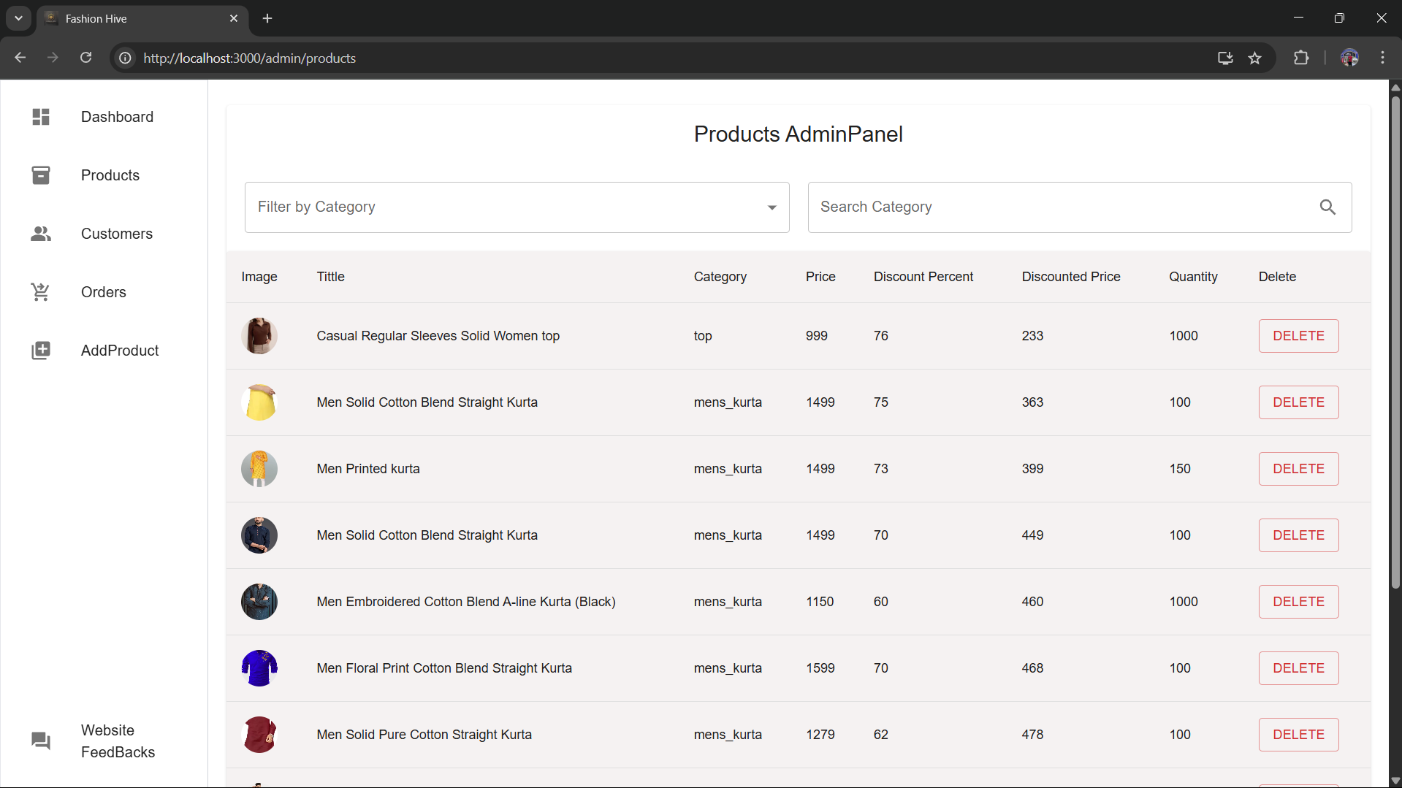
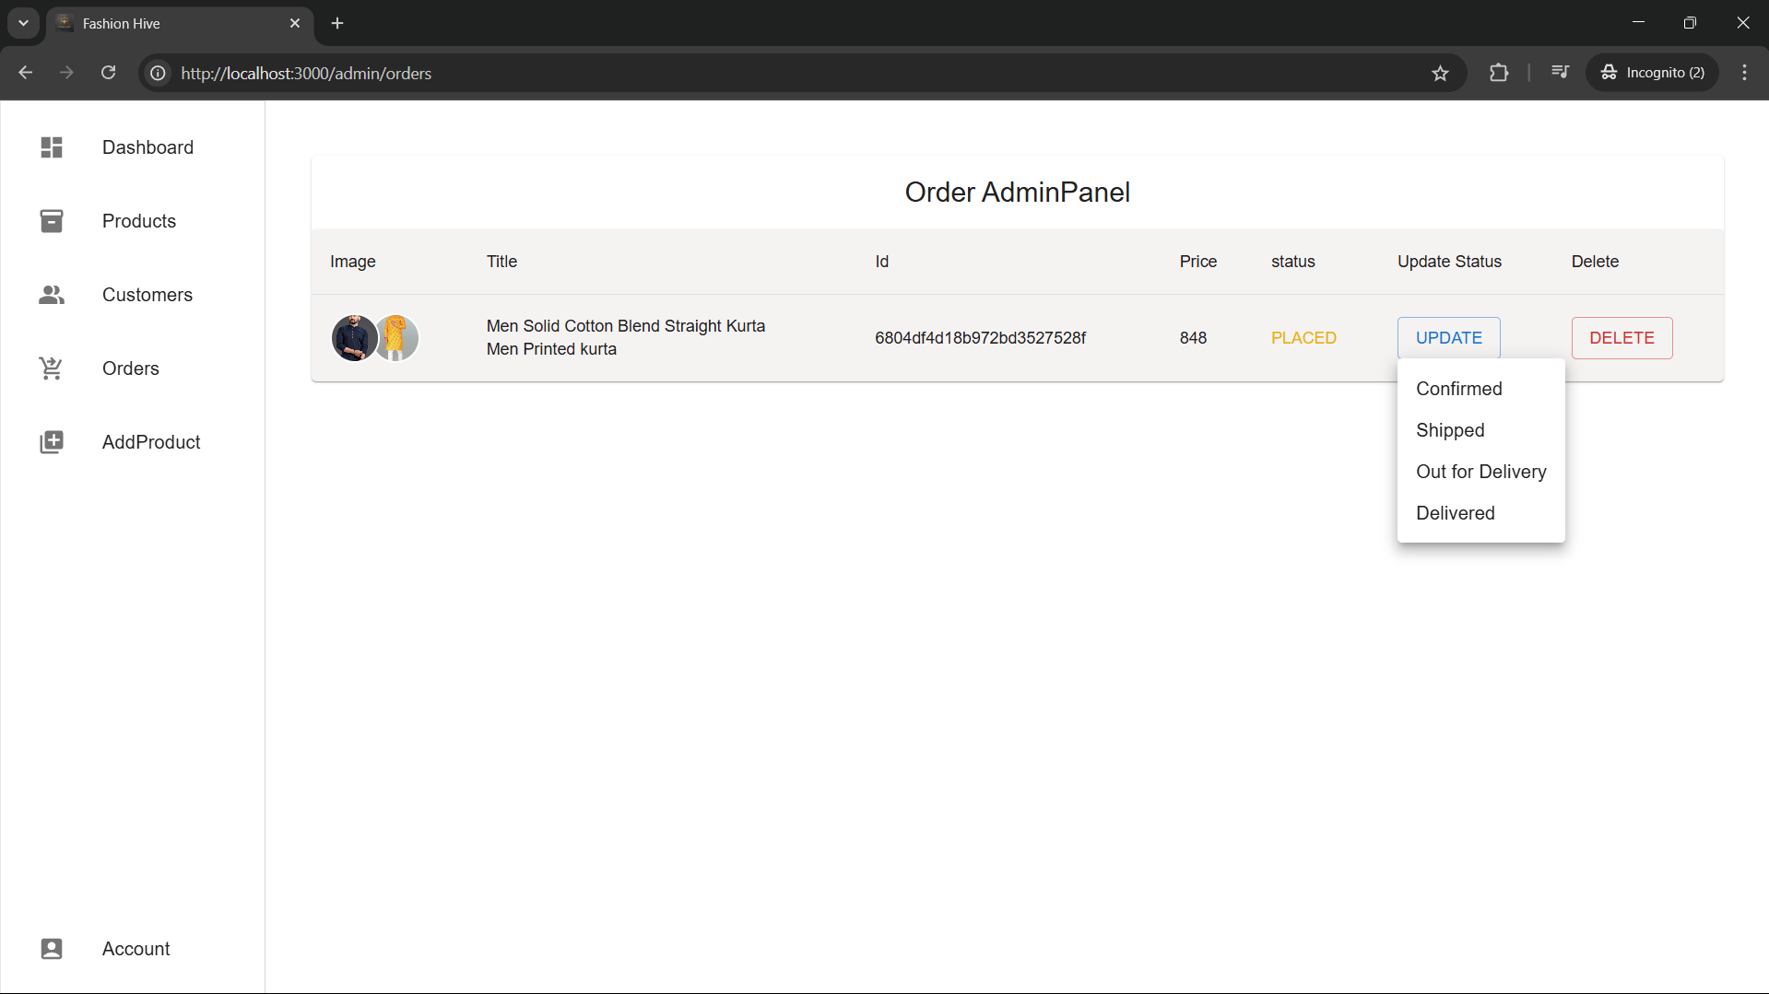
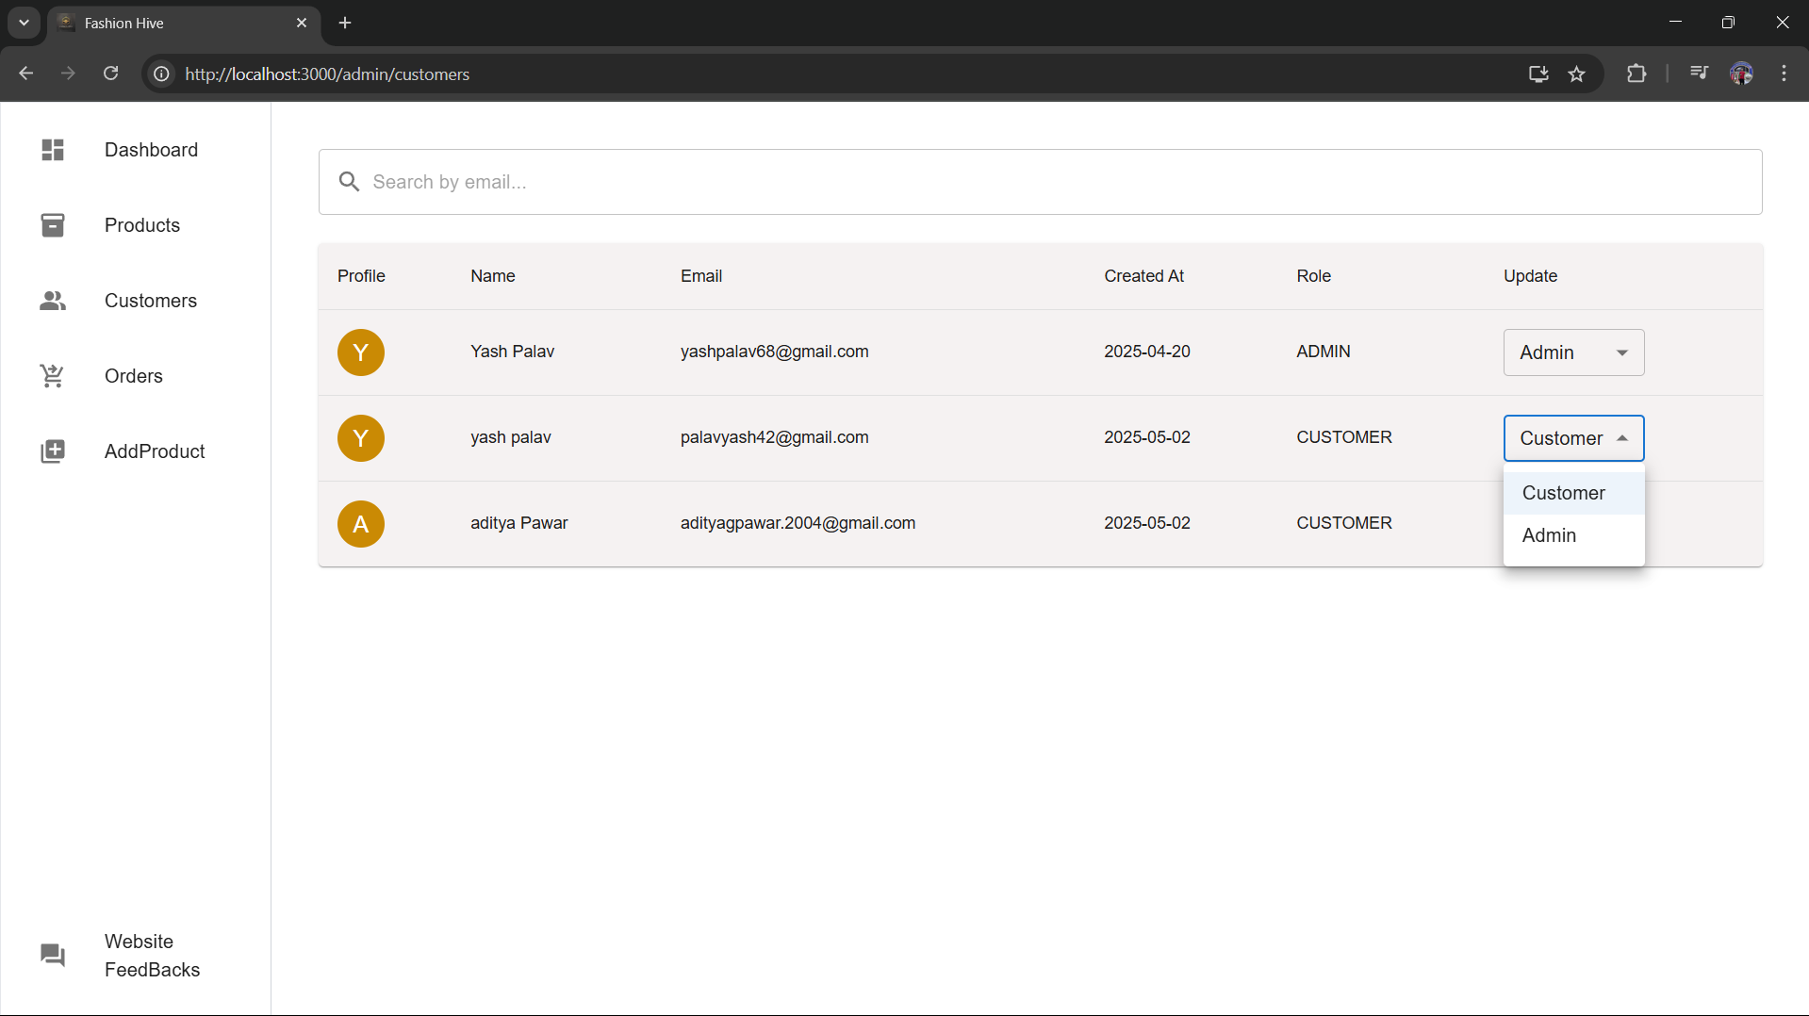
Admin Panel Overview
Product Management
User Roles
Admins can change user roles between ADMIN and CUSTOMER as needed.
Add, edit, or delete products to keep inventory up to date.
Order Status
Update order statuses which reflect immediately to users.

Slide 7
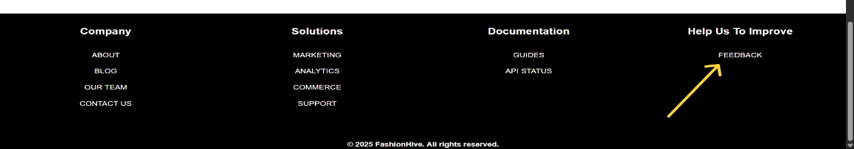


User Feedback System
Feedback Submission
1
Admin Review
Users can submit feedback via a button in the website footer.
Admins access and review all user feedback to improve the platform.
2

Slide 8
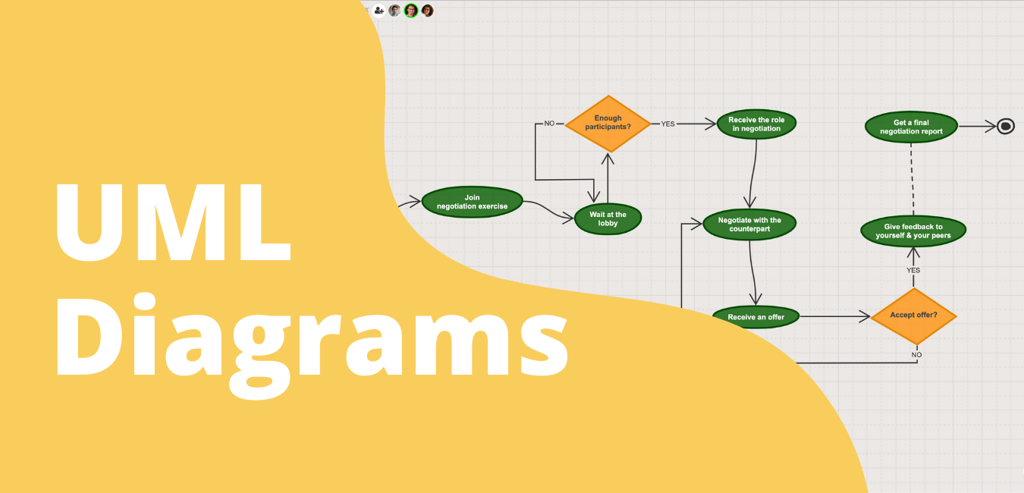
UML Diagrams: Visualizing System Architecture
UML diagrams provide a standardized way to visualize and design software systems. The use case diagram illustrates how users browse, order, and review products, while admins manage inventory and user roles. These diagrams clarify system scope and functional requirements for all stakeholders.

Slide 9
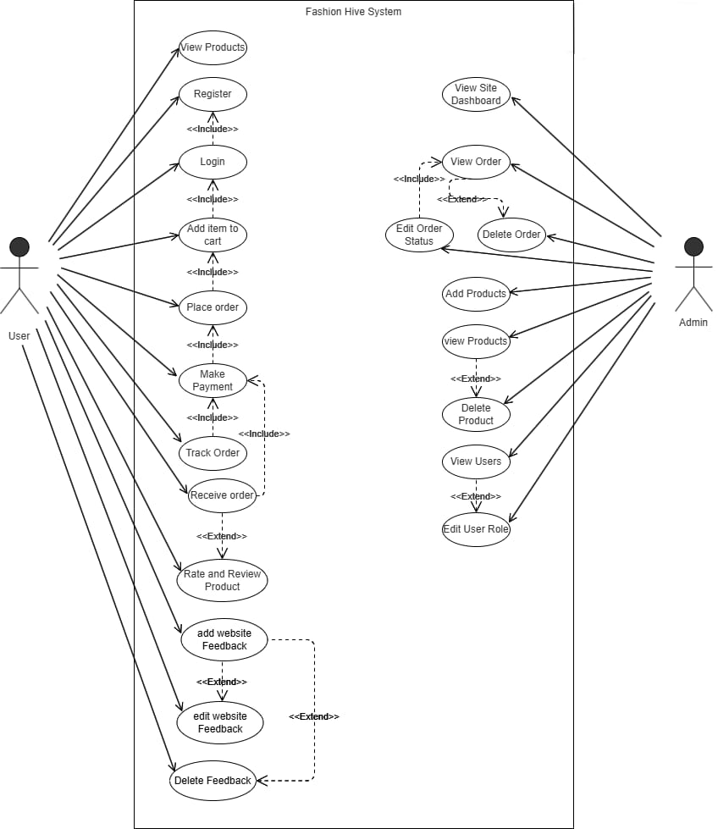
Use-case Diagram:
The Use Case Diagram outlines the interactions between external users (actors) and the system, capturing functional requirements.
Actors:
User: Browses products, adds to cart, places orders, and reviews items.
Admin: Manages inventory, customer orders, and user roles.

Slide 10
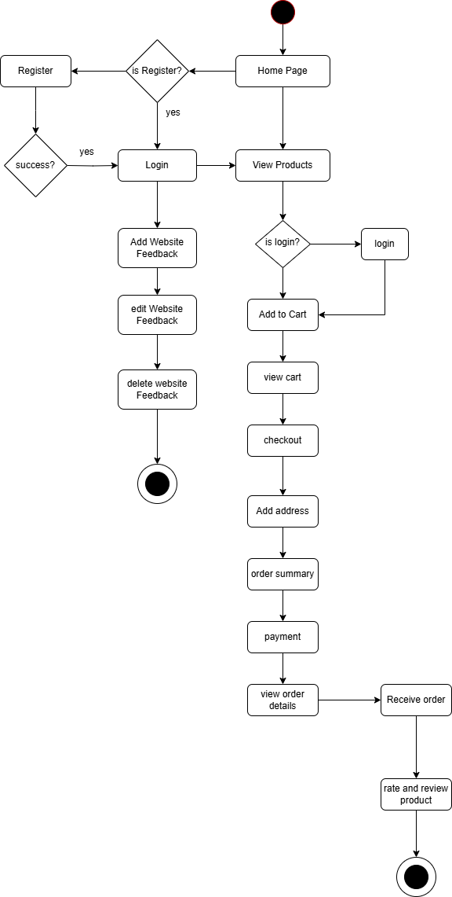
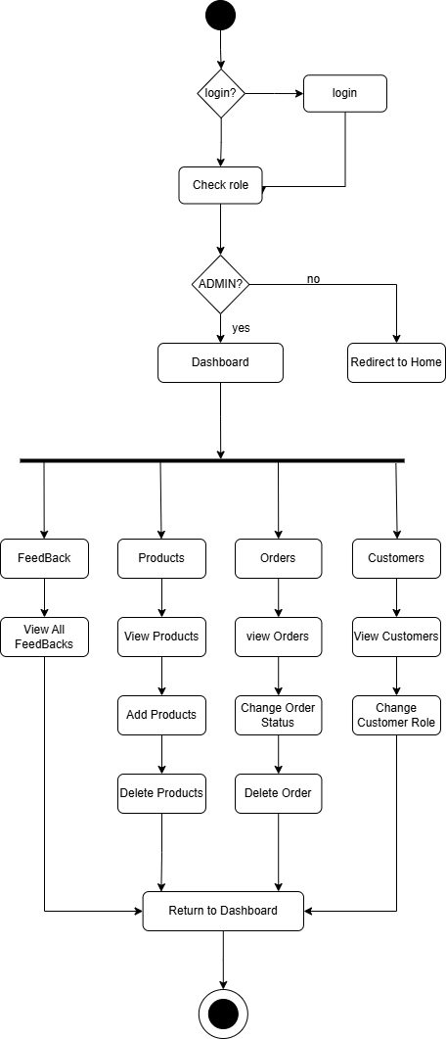
Activity Diagram(user):
Activity Diagram(Admin):
To demonstrate the workflow of a user, from registration to order completion.
To outline the steps an admin follows to manage system operations.

Slide 11
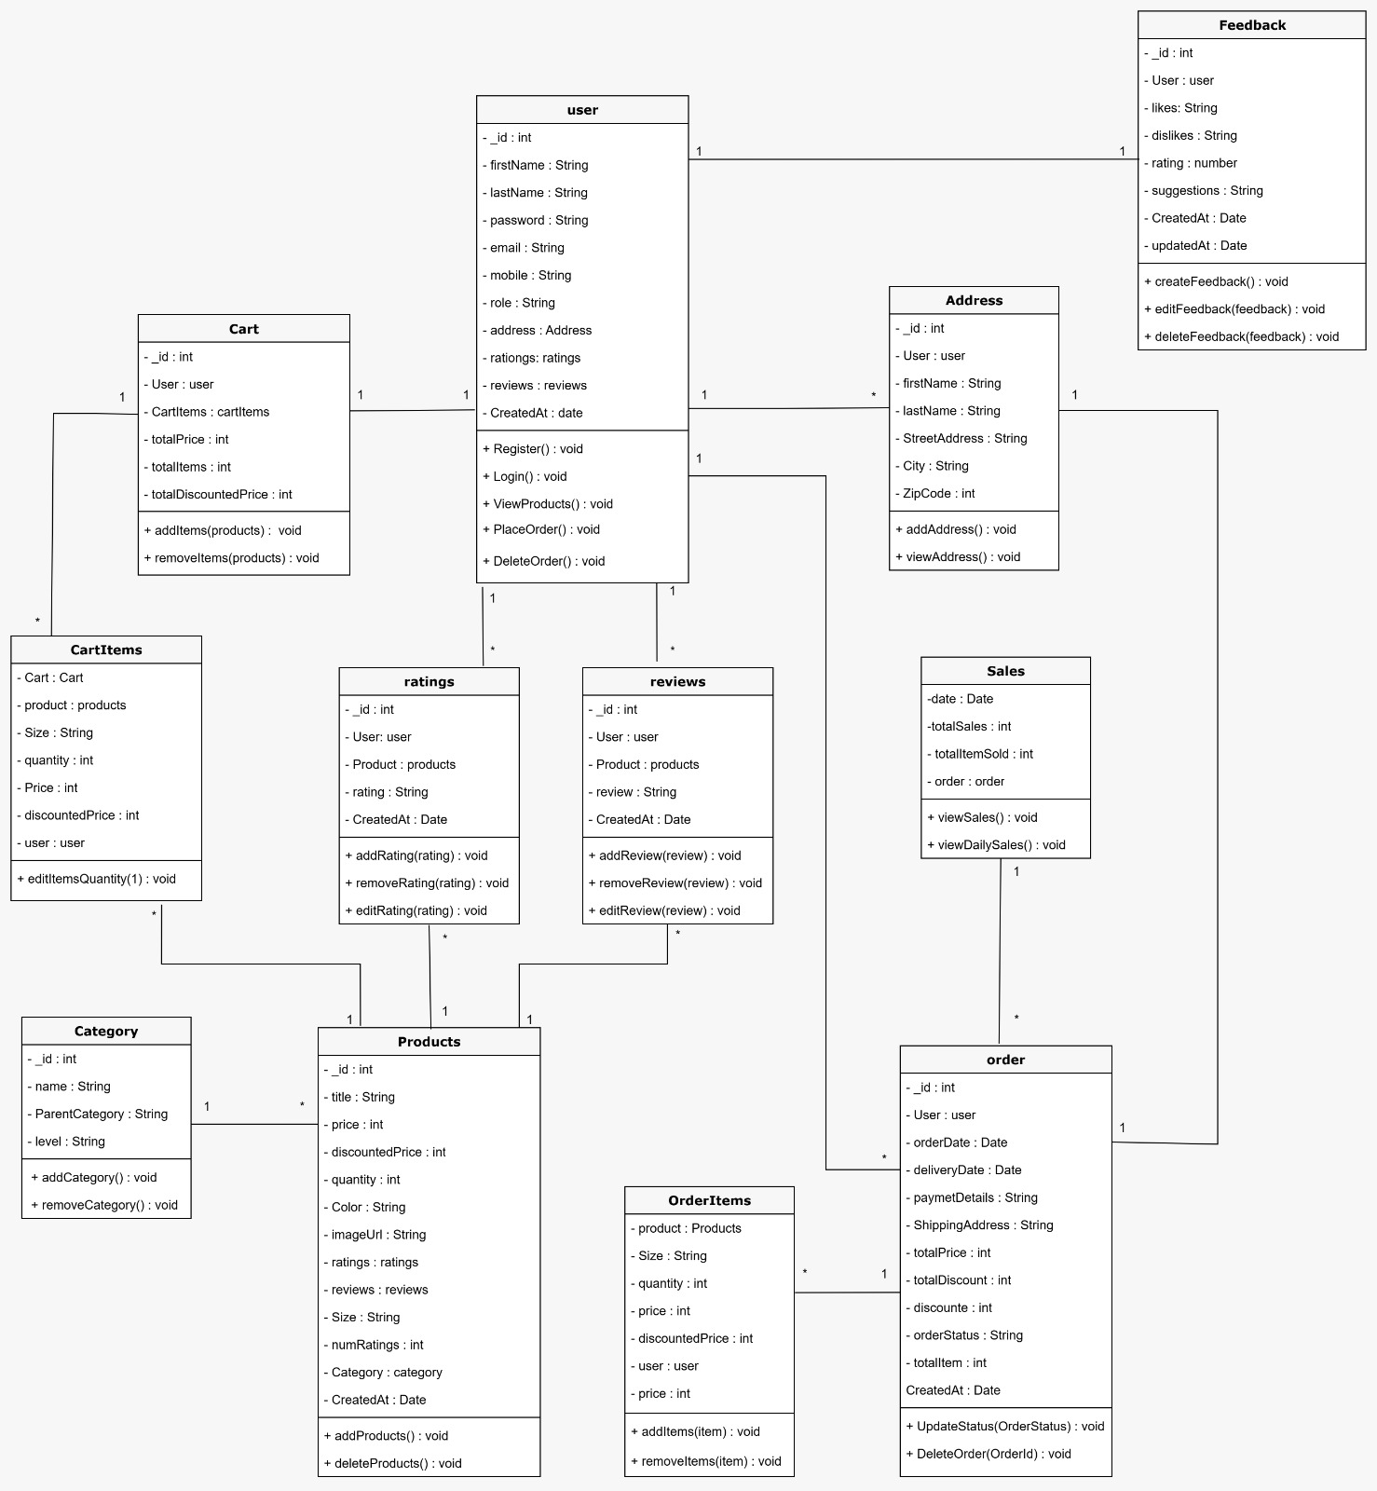
Class Diagram:
The Class Diagram displays the static structure of the system its classes, attributes, methods, and the relationships between them.

Slide 12
Detailed UML Diagrams & Conclusion
Activity and class diagrams map user and admin workflows and system structure, ensuring clarity in development. UML diagrams bridge communication between technical and non-technical teams, guiding the project from planning to deployment. For Fashion Hive, they minimize ambiguity and support a robust, scalable e-commerce platform.

Slide 13

Technology Stack & Modules of Fashion Hive
This presentation explores the core technologies and modules powering the Fashion Hive e-commerce platform. We will cover the technology stack, folder structures, integration processes, key functionalities, and future growth plans. Our goal is to provide a clear understanding of how modern tools and frameworks come together to build a seamless, secure, and scalable digital fashion retail system.

Slide 14

Core Technologies Used
MongoDB
Express.js
A NoSQL database storing flexible JSON-like documents, ideal for complex data like products and orders.
Lightweight Node.js framework simplifying backend API creation and routing.
React.js
Node.js
JavaScript library for building fast, interactive, and reusable frontend UI components.
JavaScript runtime enabling server-side code execution for consistent full-stack development.

Slide 15

Technology Layers & Purposes
Frontend
React.js
Build responsive, interactive interfaces
Styling
Tailwind CSS
Utility-first CSS framework for styling
State Management
Redux
Efficient global state handling
Backend
Node.js, Express.js
RESTful APIs and server logic
Database
MongoDB
Store and manage NoSQL documents
Payment
Razorpay
Secure online payment processing

Slide 16
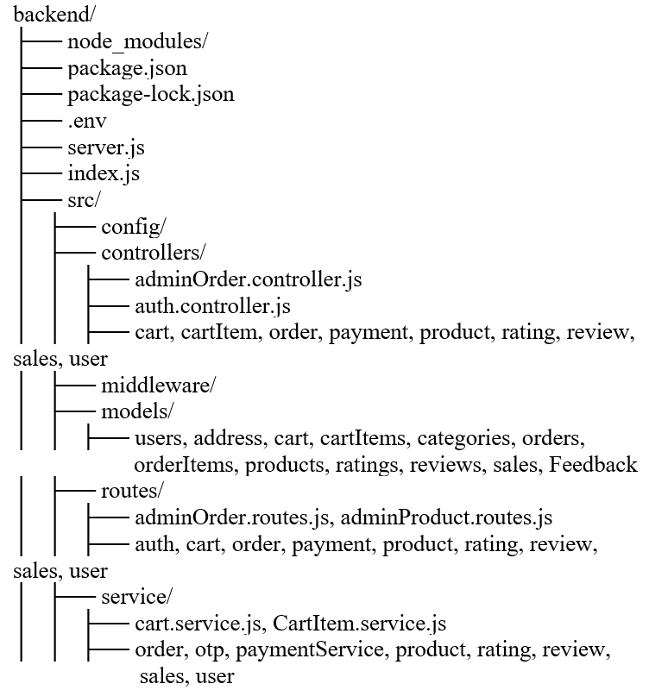
Backend Folder Structure Overview
Key Directories
Controllers & Services
Includes config, controllers, middleware, models, routes, and services for modular code organization.
Handle business logic for orders, payments, products, users, and more.
Models & Routes
Define data schemas and API endpoints for seamless backend operations.

Slide 17
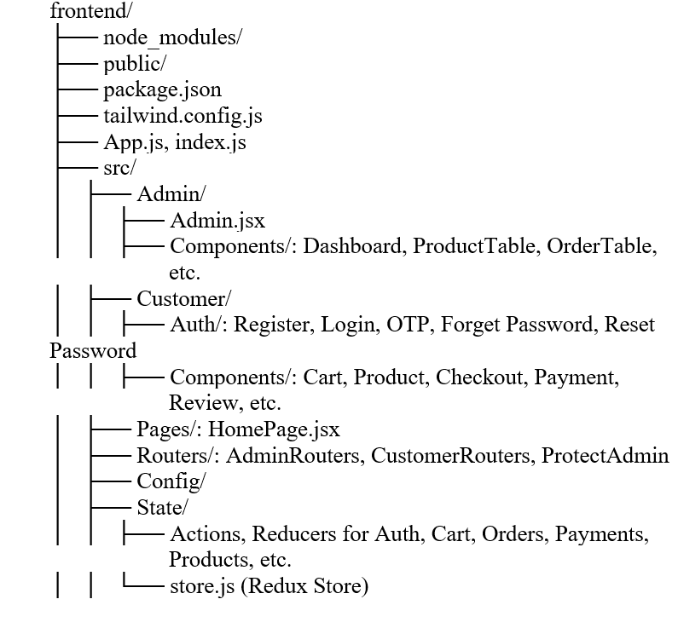
Backend Folder Structure Overview
Admin & Customer Modules
Pages & Routers
Separate folders for admin dashboard and customer features like authentication and cart management.
HomePage, routing components, and protected routes for user access control.
State Management
Redux store with actions and reducers managing authentication, cart, orders, and payments.

Slide 18




Frontend-Backend Integration & API Testing
Integration Approach
Used Axios for asynchronous HTTP requests, centralized API endpoints via environment variables, enabling real-time data updates without page reloads.
API Testing
Frontend tested button clicks and form submissions, backend tested with Postman to ensure correct responses and data consistency.
UI Feedback
Implemented loading indicators and success/error messages for smooth user experience.

Slide 19
Razorpay Payment Gateway Integration
Backend Setup
Frontend Setup
Configured Razorpay API keys securely, implemented order generation and payment signature validation logic.
Integrated Razorpay checkout script, enabling a seamless payment modal with pre-filled customer details for smooth transactions.

Slide 20
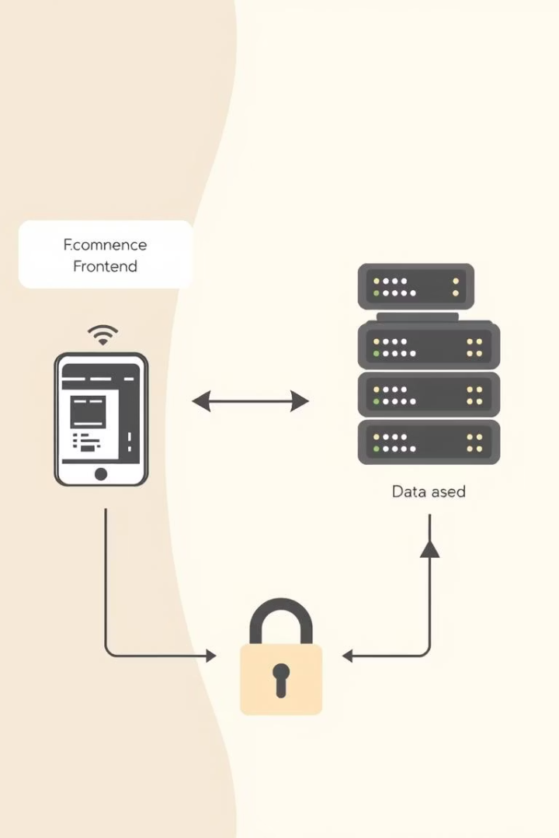
System Integration & Key Considerations
Dynamic User Interaction
Security & Responsiveness
User actions update backend data in real-time, reflecting instantly on the UI.
API keys protected, error handling implemented, and design optimized for all devices.
Smooth Experience
Minimal page reloads ensure a fluid shopping and checkout process.

Slide 21

System Requirements
Category
Specification
Details
🖥️ Web Users
Device
Smartphone, Tablet, or PC (2 GB RAM min)
OS
iOS 13+, Windows 10+, macOS 10.15+
📱 Mobile
Requirements
Android 8.0+, iOS 13+
OS
RAM: 2 GB or more, Browser/WebView compatible
Internet
512 Kbps minimum (2 Mbps recommended)
JavaScript
Must be enabled
Storage
Enough for browser + cache (~100MB)
Browser
Modern browsers supported (Chrome v90+, Firefox v90+, Safari 13+ recommended)

Slide 22
Conclusion & Future Scope
Smart Recommendations
Use AI to personalize product suggestions based on user behavior.
Augmented Reality
Enable virtual try-on features to boost confidence and reduce returns.
Mobile Apps & Marketplace
Develop native apps and expand to a multi-vendor platform for broader reach.
Customer Engagement & Admin Tools
Introduce chatbots, and advanced analytics dashboards.
Inclusive Design
Add multilingual support and accessibility features for wider usability.
Fashion Hive combines modern technology and strategic foresight to deliver a scalable, secure, and user-friendly e-commerce platform ready to evolve with future retail trends.

